Slide 1

LARIDAE
AN ENHANCED WEATHER MONITORING SYSTEM
CEP AND ML BASED APPROACH

Slide 2
R&D PROJECT – FINAL EVALUATION
TEAM MEMBERS :
110075R : H. M. C. Chandrathilake
110221M : H. T. S. Hewawitharana
110258G : R. S. Jayawardana
110597T : A. D. D. Viduranga
SUPERVISORS: Dr.Dilum Bandara
Ms.Madushi Bandara
Dr.Srinath Perera
Dr.Suresh Marru

Slide 3
Contribution
This projects is an attempt to answer the drawbacks of current weather forecasting approaches by pre-processing the weather data using Complex Event Processing and Machine Learning. The system is consisted of following main components.
ML based clustering
module
Complex, weather
processing module
CEP based filter
1

Slide 4
Introduction

Slide 5

Weather forecasts…
Very important and need to be timely and accurate
But weather algorithms have to process too much data
3
Notes:
Weather forecasts- All of us need them in our day to day lives. For a weather forecast to be useful, it needs to be timely and accurate. But.. Usually the weather forecasting models have to process lots and lots of data. So, most of the times, they have to either process a smaller amount of data to reduce the run time and get a quicker forecast with a lower accuracy or take a longer time and process more data and give a more accurate forecast. In brief, you can have quick forecasts at the cost of accuracy or you can have accurate forecasts at the cost of speed. But both of these are important. What if we try to achieve both? Well, that’s our motivation for the project.

Slide 6

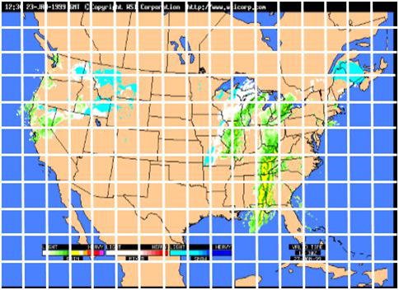
The Real Problem
Data collection is,
Static
Fixed-Cycle
Low Resolution
4
Notes:
So what is the real problem with traditional weather forecasting methods?
They use static and fixed cycle data collection. We’ll look at an example. As you can see in this image, data from each grid location are continuously gathered and processed to find out weather events. The grid resolution doesn’t change in doing that. That’s called static data collection. And you can see that the actual events happen in very small areas. But, to find that, you have to process data from the entire area which is quite a large amount of data. So the processing of most of the areas are in vain in the end.

Slide 7
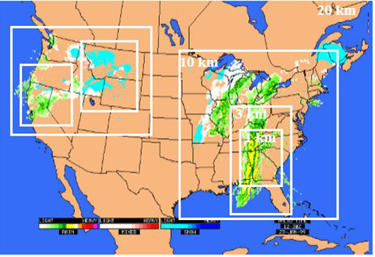
The Answer!
Identifying interesting areas if any
Increasing the data collection resolution
Increasing the data collection frequency
5
Notes:
So, our project, proposes an answer for this. What we do is, before processing data, we identify the areas in which a particular weather event is likely to happen. And then, we filter out the data from the rest of the areas and we get data from the identified areas in a higher resolution and a higher frequency. This way, both time and resources will be consumed less because lots of unnecessary data are now filtered out, and the accuracy will also be increased because the resolution and frequency is increased.

Slide 8
Solution Architecture

Slide 9
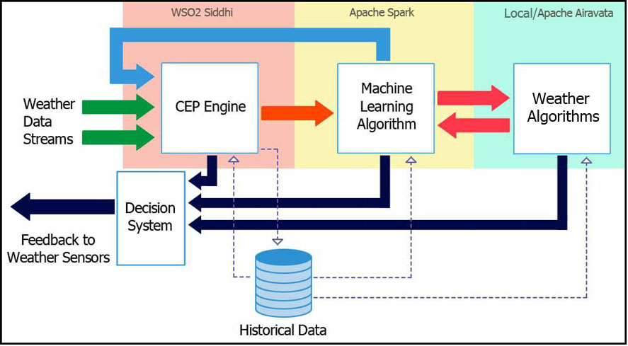
High Level Solution…
7
Notes:
This is the high level solution architecture that we propose. As you can see, there are 3 basic components in it. Weather stream data is first fed into a CEP engine, where the filtering of data happens. Then the filtered data stream is forwarded into the ML sub-system along with the boundary of the bounding box of filtered data. There what happens is, the geographical distribution of data are clustered. Finally, the data stream is made available to the Weather algorithms, WRF model in our case, along with boundaries of each cluster. There, the WRF model runs for each cluster separately and give outputs corresponding to each cluster.
And to demonstrate this concept, we selected a particular weather event type- thunderstorms.
Now we’ll have a detailed look at each of these components and their tasks.

Slide 10
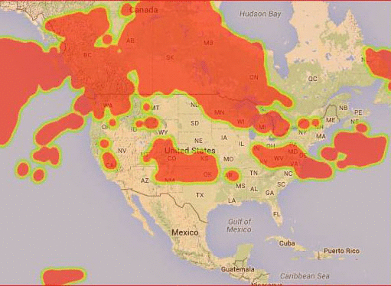
Selected Case
2006 December, 19-20
Decatur, United States
3 -Hourly Data in GRIB* format
* GRIB is a data format dedicated to handle weather data
8
Notes:
To better understand each of the components of the above architecture, we associated the selected weather case and describe the data flow with it. So this is the weather case that we selected – a thunderstorm occurred at Decatur, US on December 19/20, 2006. Data are obtained at 3 hour gaps in GRIB format. GRIB format is a dedicated data format to handle weather data.

Slide 11
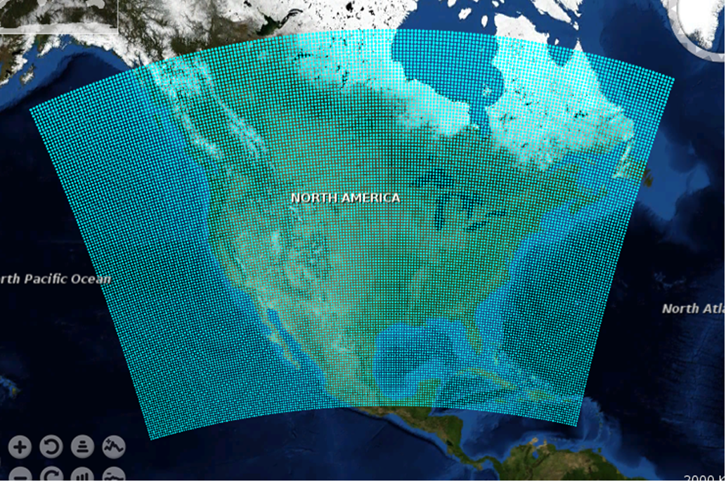
Initial Data Coverage
9
Notes:
Initial weather DataStream covers the entire North America region. Each of the dot represents a weather data sensor position.
The data stream includes lot of unnecessary data and sometimes no interesting weather event occurs in the whole area and all of the data can be ignored in that time interval

Slide 12
High Level Solution…
10
Notes:
The first layer of Laridae is the CEP based filtering layer. This is developed with WSO2 Siddhi CEP engine. This is where the full traffic is going to hit. So as well as the accuracy, CEP processing is required to be light weight and fast. Siddhi CEP engine is considered one of the fastest CEP processing engines available and it is open source.

Slide 13
CEP Filtering Layer
Complex Event Processing
Filtering using weather indices
Monitoring data streams in real time
Identifying complex relationships among events (data)
We used it to monitor weather stream data
Lifted Index
Storm Relative Helicity
Convective Inhibition
Goals
Lifted Index
LI ≥ 0K : Stable atmosphere - no thunderstorms possible
0K > LI ≥ −2K : Thunderstorms possible
−2K > LI ≥ −6K : Thunderstorms likely
−6K > LI : Severe thunderstorms likely
Anomaly detection
Filtering
11
Notes:
Complex Event processing is used to monitor data streams in realtime and identify events and relationships between events. We use CEP to monitor weather data stream and filter events that would indicate thunderstorms.
Weather data filtering is done with threshold limits of these indices. There are weather indices that are specifically designed by meteorological community to identify thunderstorms. Three of those indices which are Lif.. Sto.. Con.. Used in our application.
For data filtering, we used Length windows with length of 50. Siddhi CEP process the data stream by collecting batches with 50 events at a time.
For creating the minimum bounding box of the filtered data, we used Time Window with 10 second time gap. Currently this window is enough to process the entire datastream of the area and pass the boundary, but if the time window was insufficient, CEP will return boundaries for currently processed data for every 10 seconds.
The primal goal of CEP layer is filter the weather data stream with thunderstorm indices and output a vague boundary which passed to the next layer.
CEP layer also monitor the datastream for anomalies and faulty sensor data and they are filtered by this layer

Slide 14
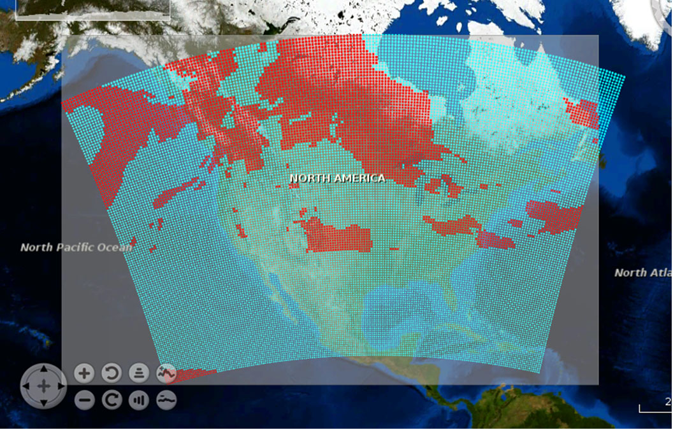
CEP Filtered Data
12
Notes:
CEP Filters the datastream and returns this boundary.

Slide 15
High level solution…
13
Notes:
After CEP passes the filtered data with their minimum bounding box, filtered data points are passed to the next layer of Laridae which is an ML based preprocessing layer.

Slide 16
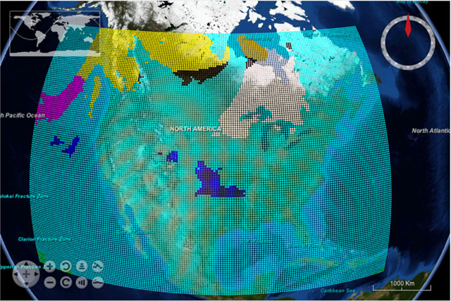
ML Clustering Layer
Used to
Cluster the data points
Get localized boundaries
2 Algorithms used
K-means
Gaussian Mixture Model
Apache Spark
14
Notes:
Machine Learning layer is used to cluster the data points and identify each individual interesting weather events. This will help to get localized boundary from the data stream and filter out more unnecessary data.
For development of this layer we used Apache Spark and it’s Machine Learning Library. Spark is used because of the big data processing requirements in this layer. CEP datastream is collected and processed as a batch. Spark MLLib currently has few clustering algorithms implemented.
K-Means algorithm is one of the fastest clustering algorithms and first we researched and implemented K-Means algorithm for our application.
The Gaussian Mixture Model is also a good clustering algorithm which gives better results when the clusters are not nearly circular. But finding the optimal number of clusters is harder for Gaussian Mixture Model than K-Means algorithm
Laridae has implemented both of these clustering algorithms which can be used in the ML layer. We will be looking at how these algorithms compare in following slides.

Slide 17
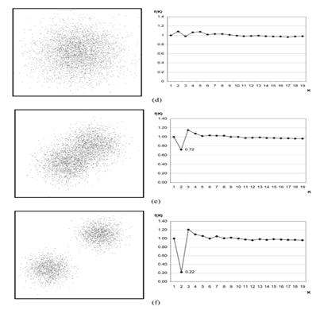
ML Clustering Layer
Standard K-Means for Clustering
Finding the ‘K’
Faster compared to other clustering algorithms
Need to specify ‘K’
Solution :
Improved K-Means
15
Notes:
The standard K-Means algorithm is faster compared to most of other clustering algorithms. But it has some limitations applying to our application. One of the problems it has is that the number of clusters has to be pre specified.
One of the researches carried out in Cardiff University of UK had some insights on an algorithm to find the optimal k value in K-Means algorithm and we implemented in our application. Simply what the algorithm do is iteratively apply a function which is build considering error rates for each K values. The function value is minimal when the K value is optimal. But for

Slide 18
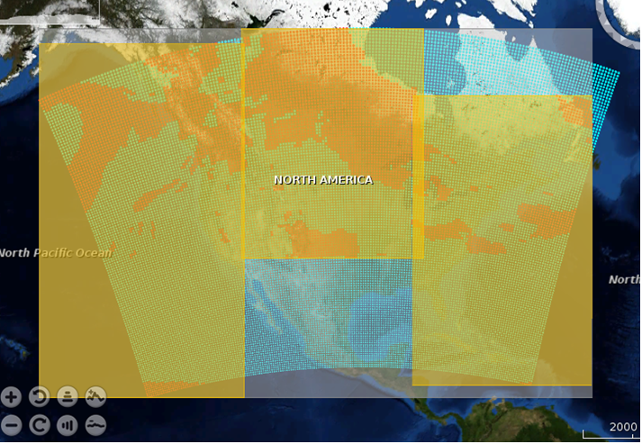
K-Means Results
16

Slide 19
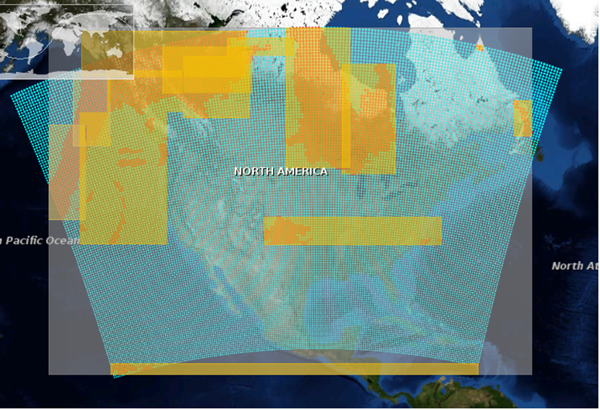
GMM Results
17

Slide 20
High level solution…
18

Slide 21
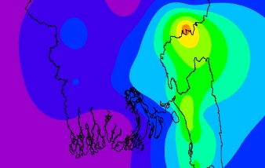
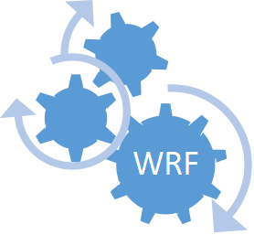
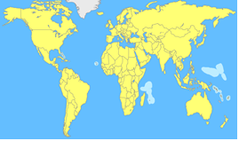

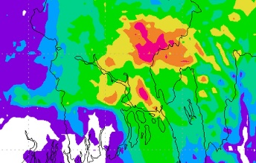

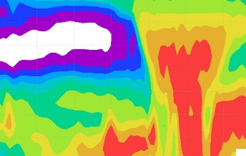
WRF Model
GRIB - data format dedicated to handle weather data
GRIB data provided to WRF model
Output is received in GRIB/netCDF
Post processing to get insight
19

Slide 22
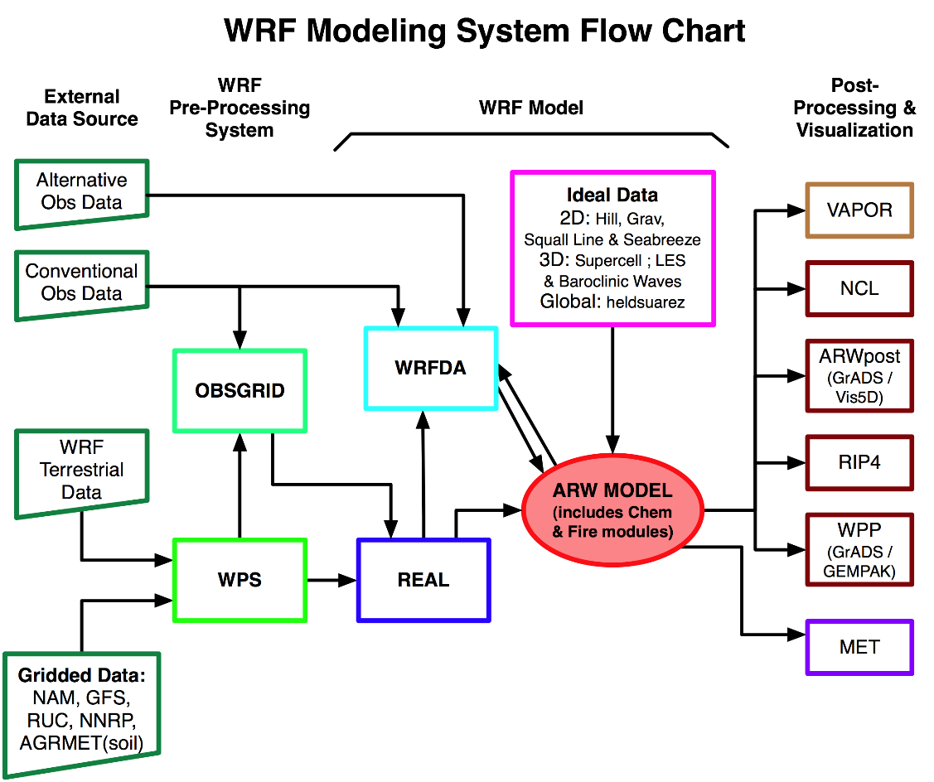
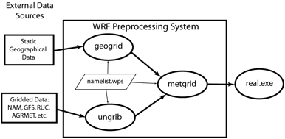
WRF Model
20

Slide 23
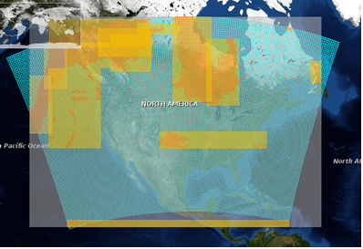
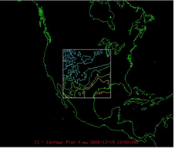
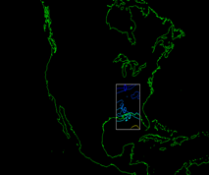
WRF Model
Namelist
Configuration
21

Slide 24
PERFORMANCE
EVALUATION

Slide 25
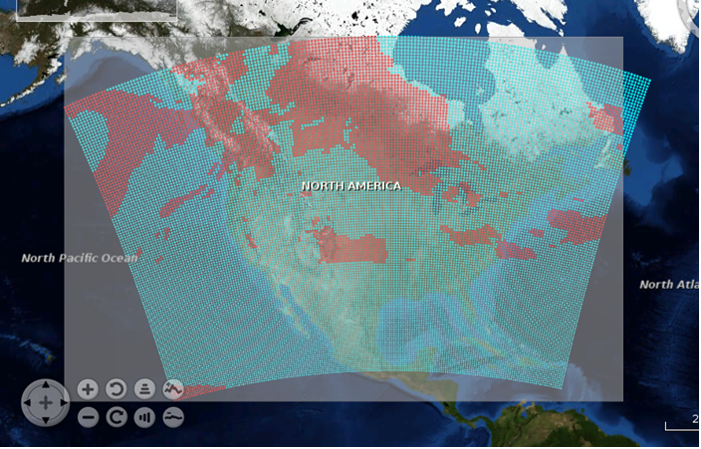
CEP Based Filtering
Using Thunderstorm Indices
Best 4 layer Lifted Index
Storm Relative Helicity
Convective Inhibition
23866 Input Data Records
Execution Time : 15.75 seconds
23
Notes:
So now let’s talk about the performance evaluation of the system. As we discussed earlier, we have considered a specific thunderstorm case in 19th to 20th of December 2006, a thunderstorm event caused in Decatur United States. The input weather data was in the GRIB format and there were 23, 866 data records available. According to the thunderstorm indices chosen to filter the input data, we considered the weather parameters Best 4 layer lifted index, storm relative helicity and the convective inhibition data from the grib input. Accordingly the siddhi cep engine could process 23,866 data records in 15.75 seconds and filter the data. You can see the visualized output from the CEP engine in the image. The filtered data from the CEP are coloured in red and data coloured in red were fed into the machine learning component.

Slide 26

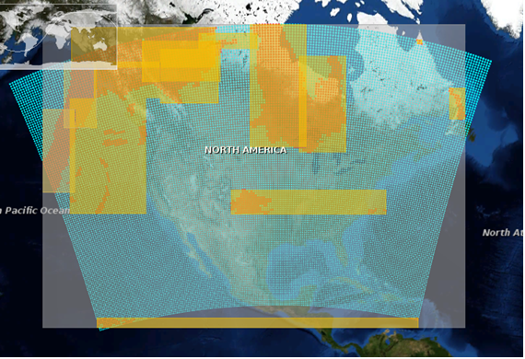
ML Based Clustering
K-Means Algorithm : 19.299 seconds
GMM Algorithm : 63.063 seconds
24
Notes:
We have followed two machine leaning approaches. Initially, we implemented the K means algorithm to find clusters of data in the CEP output. The execution time of the machine learning component, when k means algorithm was implemented was 19.299 seconds which is a small value. Out of the clustering algorithms available in the spark mllib library, we have also implemented the GMM algorithm which stands for Gaussian mixed model and its execution time was 63.063 seconds which is pretty much larger when compared with the previous approach. But when looking at the clusters they created, it is clear that the second approach gives an accurate result. The clusters of the kmeans approach contains unwanted data which is inefficient.
Other clustering algorithms available in Mllib (if panel asks)
k-means
Gaussian mixture
power iteration clustering (PIC)
latent Dirichlet allocation (LDA)
bisecting k-means
streaming k-means

Slide 27
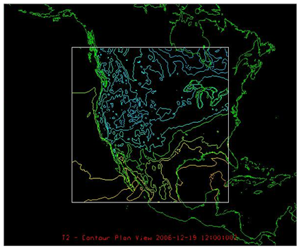
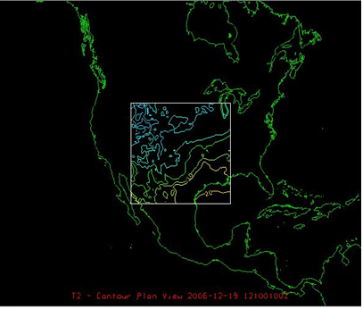
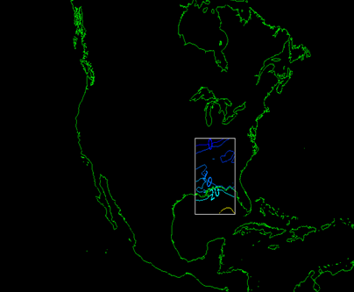
Results Comparison
Scenario 1
Scenario 2
Scenario 3
Without Preprocessing
Total Execution Time :745 seconds
Clustering using K Means
WRF Execution Time : 165.632 seconds
Total Execution Time : 205 seconds
Clustering using GMM
WRF Execution Time : 73.978 seconds
Total Execution Time : 153 seconds
25
Notes:
After WRF integration to the system, the evaluation was done under three scenarios. The first scenario was the execution of the input file in wrf without doing any preprocessing. That means, data filtering was not applied in this case. The execution time of this scenario was 745 seconds.
Then we tested the system using the 3 components cep, ml and wrf.
Scenario 2 is the system execution with the machine learning component which was implemented using the k means algorithm. Since the wrf execution is done parallelly, its execution time was 165.632 seconds. Along with the other components, the total execution time was 205 seconds.
Under scenario 3, after processing the cep output in the ml component which was implemented using gmm, the ml output was processed using wrf. The wrf execution time was 73.978 seconds. Accordingly, the total execution time of this process was 153 seconds.
Even though the same input was processed under 3 different cases, the location Decatur was included in all the three output files from the wrf. The system has opted out the unnecessary regions and processed the data of the rehgions where thunderstorm events are likely to be happened.

Slide 28
Execution Time Comparison
ML Algorithm Execution time
(Seconds)
Total Execution Time (Seconds)
Significant Time Gain
GMM : Expensive Algorithm But Gives Better Performance in Clustering
26
Notes:
The previous results we obtained by executing the system were plotted in graphs. The first graph compares the execution time of the ml component when executed using kmeans algorithms vs gmm algorithm. It is clear that the execution time of the second approach is greater more than two times of the execution of the first case. GMM is an expensive algorithm hence it takes a longer time to be executed. But when considering about the outputs generated by both the approaches, it was clear that the second approach was more accurate than the former one.
The second graph is based on the total execution time of the system. Blue colour is for the wrf execution without preprocessing. Green colour is for system execution time when kmeans was used as the clustering algorithm. The red colour is for the system execution when ml component was implemented using gmm. Accordingly, it is clear that the best approach is the third approach. The system has gained a significant time gain.

Slide 29
PROCESS & TESTING

Slide 30
Followed process
Git was used for version controlling
Iterative and incremental development
Inception : identified project scope
Elaboration : Delivered a working architecture that and fulfills the non-functional requirements
Construction : Incrementally filled-in the architecture code produced
Transition : Delivered the system into the production operating environment
28

Slide 31
Testing
Used Junit for unit testing
public class LaridaeTests {
//Validaing the output of get_refLat method used to edit namelist files
@Test
public void get_refLatValidate(){
assertEquals(15.0, NamelistCalc.get_refLat(new Boundary(10,20,30,40)),0.01);
}
//Validaing the output of get_refLon method used to edit namelist files
@Test
public void get_refLonValidate(){
assertEquals(35.0, NamelistCalc.get_refLon(new Boundary(10,20,30,40)),0.01);
}
}
29

Slide 32
Schedule
30

Slide 33
Project Dynamics
Chamil
Dulaj
Researching about WRF model
Integrating WRF model with system and automation
Researching about Machine Learning Algorithms
Using them in ML sub-system of the project
Ruveni
Tharindu
Researching about Complex Event Processing
Implementing the CEP sub-system
Researching about input data pre-processing
Output analysis and Interpretation
31

Slide 34
FUTURE
IMPROVEMENTS

Slide 35
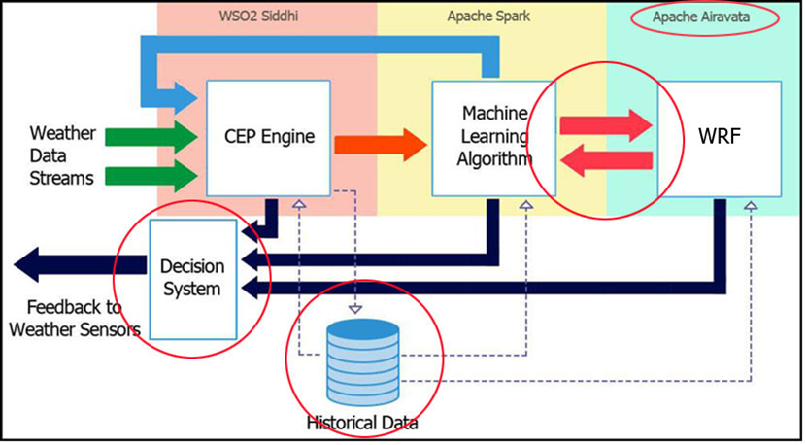
What we achieved
33

Slide 36
Enhancements
Proof of concept
Identifies only the thunderstorm signatures
Other weather indices should be added
Better algorithm to find “k” value in GMM clustering algorithm
Feeding streams of data from different weather data sources
Adapting the input data collection resolution dynamically wrt the feedback from individual components
34

Slide 37
Conclusion
We have built a successful prototype of the solution concept
Statics shows a considerable improvement of the running time of WRF module when integrated with our system
Total running time of the forecasting procedure has reduced by 75%-85% without affecting the accuracy of the results
The solution is feasible, cost-effective and can be further extended
35

Slide 38
Key References
[1]
I. L. Narangoda, S. Suhothayan, S. Chaturanga, K. Gajasinghe, S. Perera, and V. Nanayakkara, “Siddhi: A Second Look at Complex Event Processing,” 2011.
[2]
B. Pale et al., “Towards Dynamically Adaptive Weather Analysis and Forecasting in LEAD” 5th International Conference, Atlanta, GA, USA, May 2005, pp. 624-631, doi: 10.1007/11428848_81.
[3]
S. Marru et al., “Apache Airavata: A framework for Distributed Applications and Computational Workflows,” SC 2011 Workshop on Gateway Computing Environments: Seattle, WA, USA, pp. 21-28, doi:10.1145/2110486.2110490.
[4]
W. Skamarock et al., “A description of the advanced research WRF version 2”, No. NCAR/TN-468+ STR, National Center for Atmospheric Research Boulder Co Mesoscale and Microscale Meteorology Div, 2005.
[5]
D. T. Pham et al., “Selection of K in K-means Clustering,” Manufacturing Engineering Centre, Cardiff University, Cardiff, UK, DOI: 10.1243/095440605X8298.
[6]
B. Plale, D. Gannon, J. Brotzge, K. Droegemeier, J. Kurose, D. McLaughlin, R. Wilhelmson, S. Graves, and M. Ramamurthy, “CASA and LEAD: Adaptive Cyberinfrastructure for Real-Time Multiscale Weather Forecasting,” IEEE Computer Society, 2006.
36

Slide 39
THANK YOU!

Slide 40
BACKUP SLIDES

Slide 41
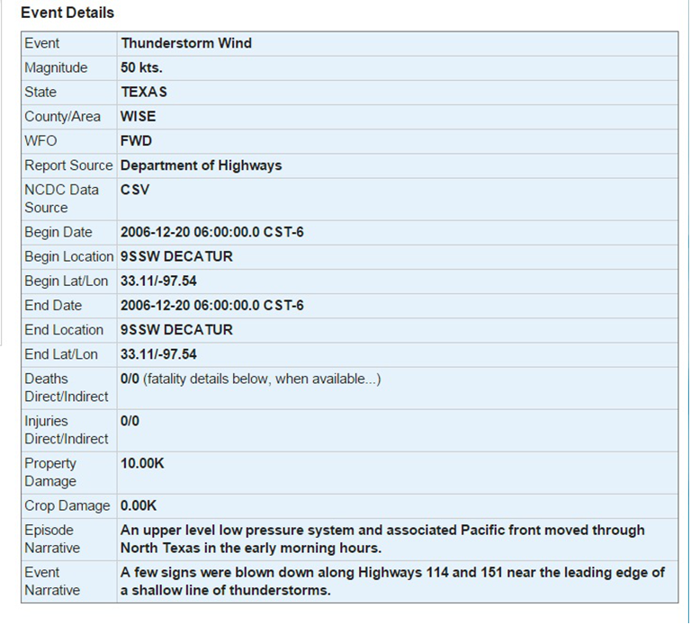

Slide 42
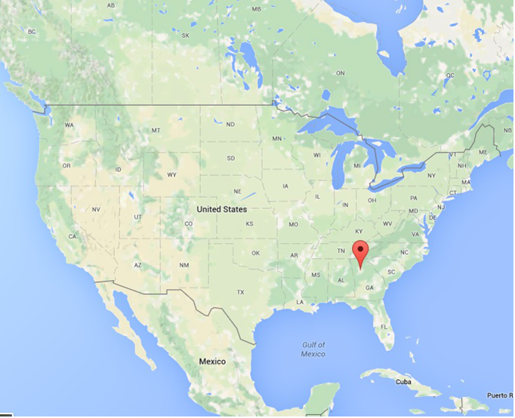

Slide 43
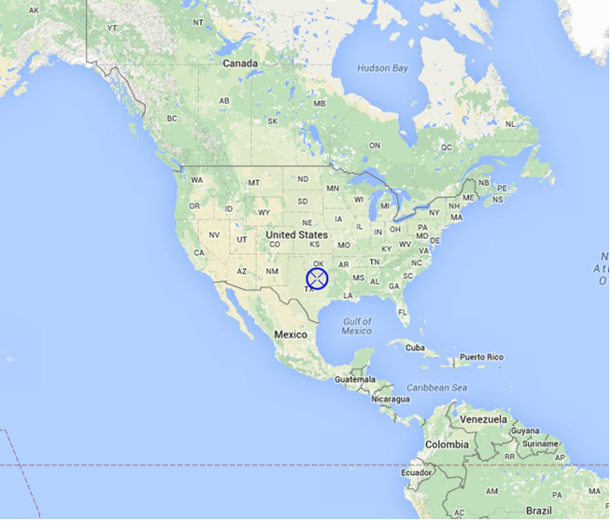

Slide 44
&share
wrf_core = 'ARW',
max_dom = 2,
start_date = '2008-03-24_12:00:00','2008-03-24_12:00:00',
end_date = '2008-03-24_18:00:00','2008-03-24_12:00:00',
interval_seconds = 21600,
io_form_geogrid = 2
/
&geogrid
parent_id = 1, 1,
parent_grid_ratio = 1, 3,
i_parent_start = 1, 31,
Figure 4.18 - namelist.wps file contents
j_parent_start = 1, 17,
s_we = 1, 1,
e_we = 74, 112,
s_sn = 1, 1,
e_sn = 61, 97,
geog_data_res = '10m','2m',
dx = 30000,
dy = 30000,
map_proj = 'lambert',
ref_lat = 34.83,
ref_lon = -81.03,
truelat1 = 30.0,
truelat2 = 60.0,
stand_lon = -98.,
geog_data_path = '/mmm/users/wrfhelp/WPS_GEOG/'
/
&ungrib
out_format = 'WPS',
prefix = 'FILE',
/
&metgrid
fg_name = 'FILE'
io_form_metgrid = 2,
/

Slide 45
Move to WRF Directory
Configure WRF
Compile WRF for Real Data Case
Move to WPS directory
Configure WPS
Compile WPS
Run geogrid.exe
Link the correct Vtable
Run ungrib.exe
Run metgrid.exe
Move to WRF directory again
Link the met_em files
Run real.exe
Run wrf.exe

Slide 46
Move to WRF Directory
Configure WRF
Compile WRF for Real Data Case
Move to WPS directory
Configure WPS
Compile WPS
Run geogrid.exe
Link the correct Vtable
Run ungrib.exe
Run metgrid.exe
Move to WRF directory again
Link the met_em files
Run real.exe
Run wrf.exe

